Slide 1
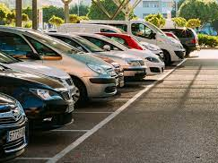


PARKING LOT MANAGEMENT SYSTEM
WEB DEVELOPMENT DECEMBER
MAJOR PROJECT
TEAM MEMBERS
VIKASH KILAKA
DEVESH YADAV
KODUMURI VARSHITHA
ASTHA AGRAWAL

Slide 2
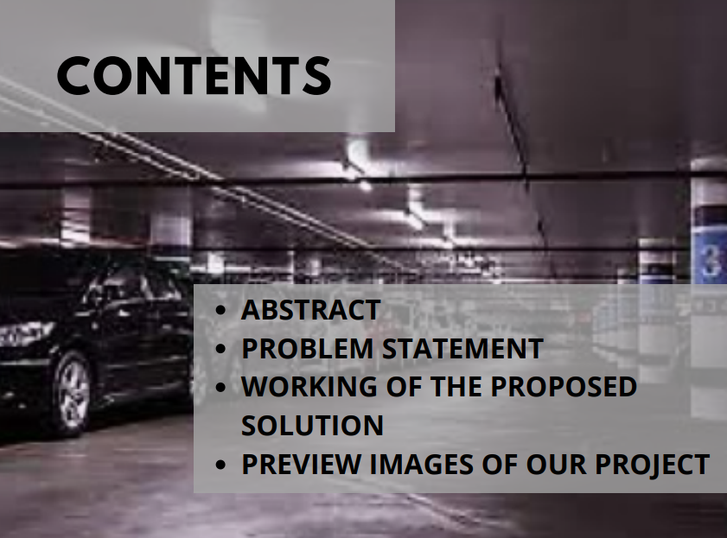

Slide 3
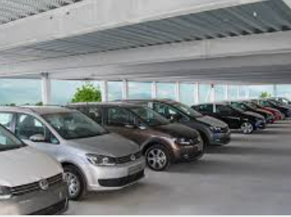
ABSTRACT
The main aim of this project is to reduce the traffic in the
parking place and manage a proper record. This project
enables one to manage the parking and provide a better
idea of parking spaces left and also provides the proper
record of vehicles parked and there in and out timimgs.
This Project will feature registrations of vehicles in the
parking lot with keeping there number plate, name and
entry-exit timings using web development, html/css,
javascript . Also this will provide a list of all vehicles in
the parking lot

Slide 4
PROBLEM STATEMENT
Normally we can see in the multiplexes, there is problem, in the management of vehicles in the parking lot. One have to go and search which line having place to park their vehicle , also some doesnot get space to park even we they have applied for space in that parking lot. It becomes time consuming process to save and manage such details on pages and becomes confusing at times. a. So to avoid this problem Car Parking System project is implemented.

Slide 5
WORKING OF PROPOSED SOLUTION
In this project we used web- development technologies i.e. HTML, CSS/Bootstrap, Javascript. It takes name, vehicle name, vehicle number and entry-exit details as input and saves it and displays it in a table which shows the cars in the parking lot

Slide 6

IMAGES REGARDING OUR
PROJECT

Slide 7
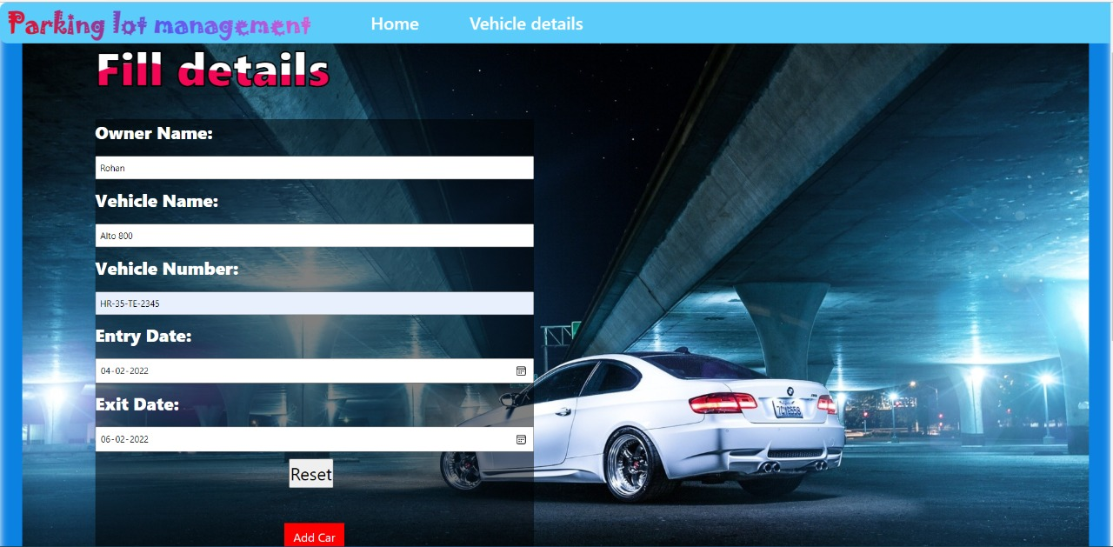
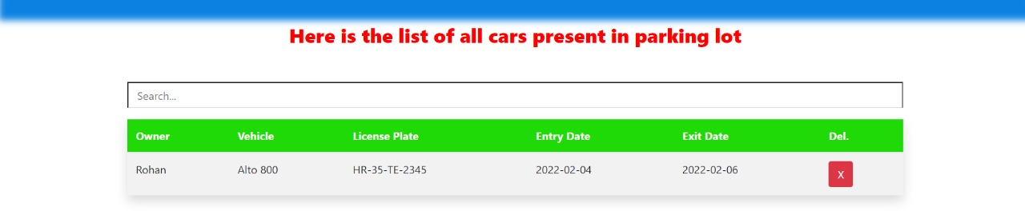

Slide 8
